Slide 1
Customizable Vehicle
Fragrance Diffuser
Phase 1 Presentation
ME 423-B
Madeline Dever
Trevor Hinds
Shannon Maroney
Christina McDonald
Notes:
maddie

Slide 2

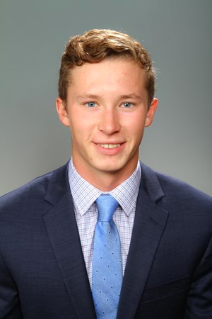
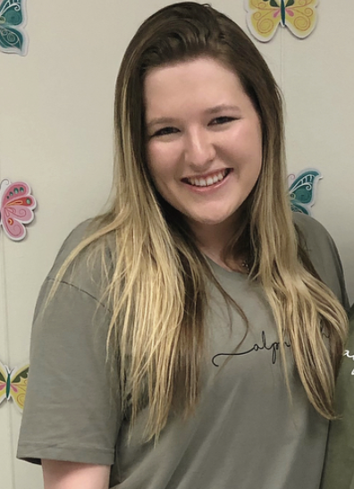
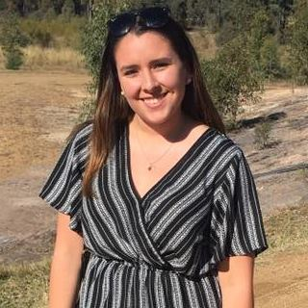
Our Team
Mechanical Engineers
Madeline Dever
Point Pleasant Beach, NJ
Trevor Hinds
Bay Head, NJ
Shannon Maroney
Rockaway Beach, NY
Christina McDonald
West Orange, NJ
Notes:
maddie

Slide 3
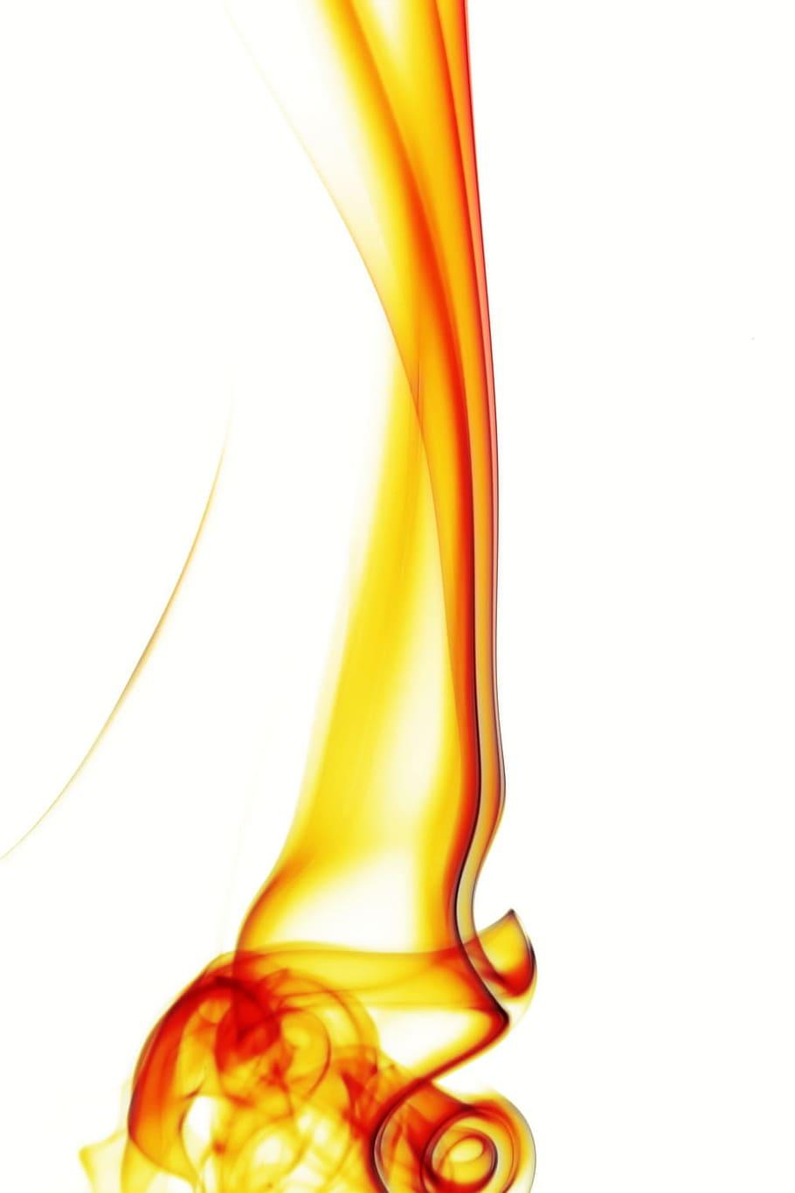
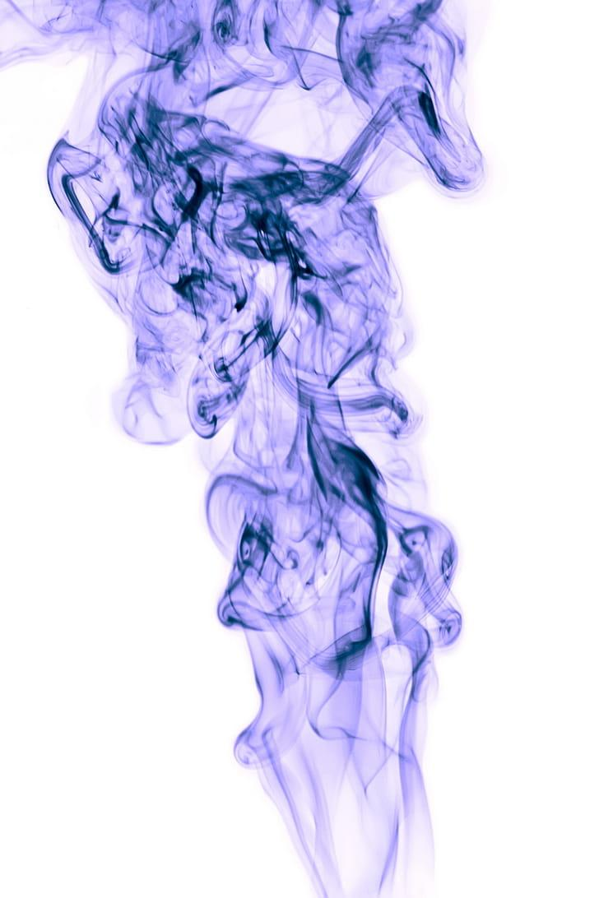


Project Statement
Customizable Vehicle Fragrance Diffuser
Sponsor: Terrance Dean
“Develop a product that can be used to change the scent within a vehicle on demand for various occasions.”
Additional features:
Multiple fragrance options
LED lights
Mist
USB ports
Timers
Air filter
Notes:
maddie

Slide 4

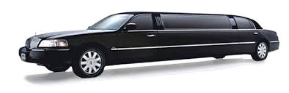


Stakeholders
Primary:
Terrance Dean
Vehicle Owners
Uber/Taxi/Limo Drivers
Secondary:
Vehicle Passengers
Vehicle Dealerships/Manufacturers
Car Wash/Convenient Stores
Notes:
maddie

Slide 5
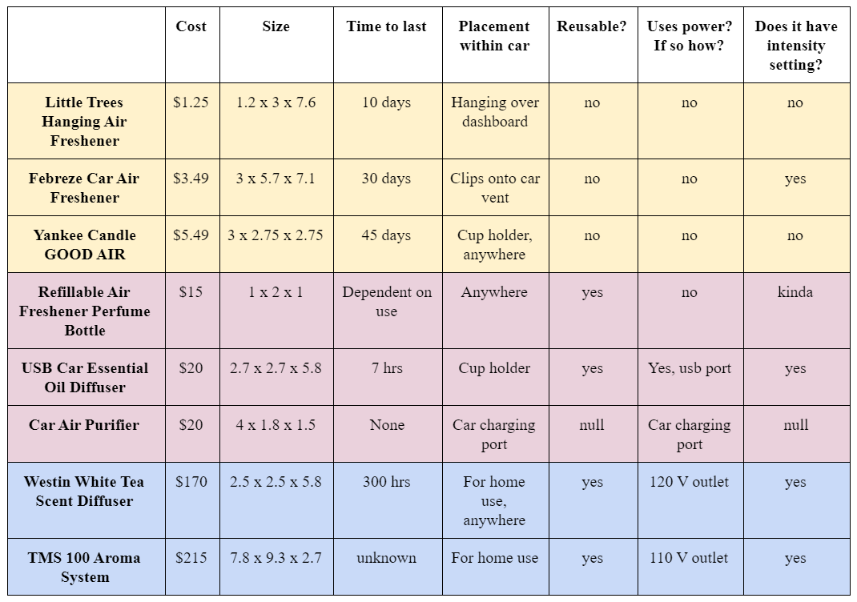
State of the Art Review
Low-Tier Product:
< $10
Mid-Tier Product:
$10 - $100
Top-Tier Product:
> $100
Notes:
Christina

Slide 6
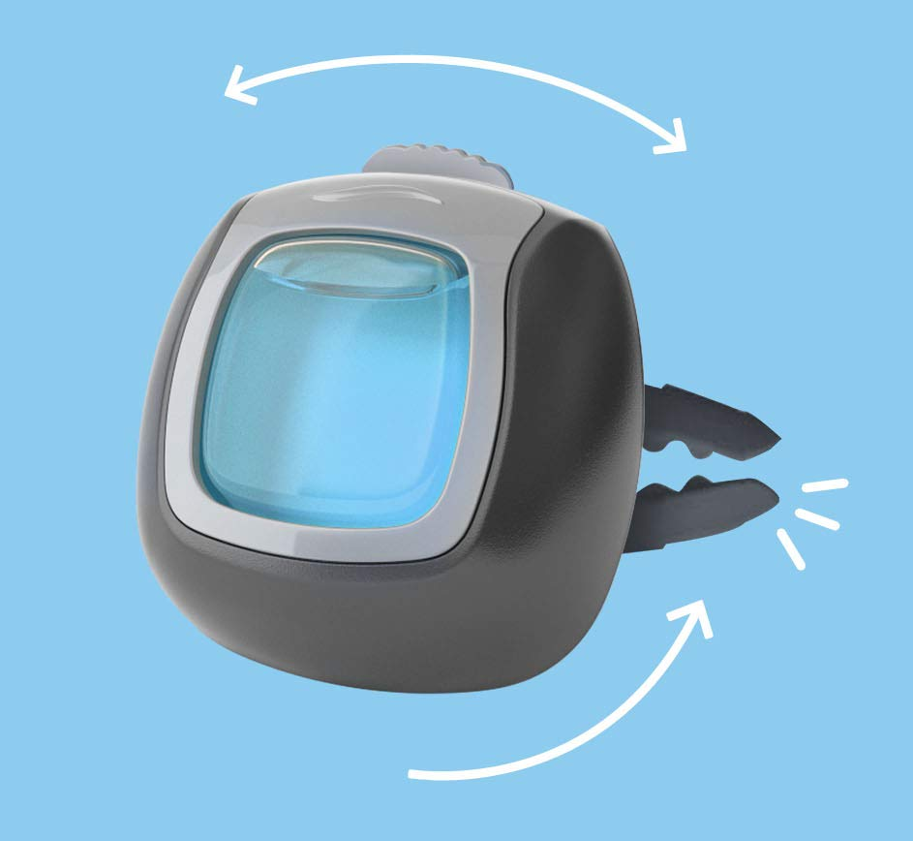
State of the Art Review
Febreze Vent Clips (Low Tier)
Reusable Product
“too expensive to just throw into the trash after four weeks of use”
Appropriate Fragrance Strength
“these are strong. Like makes my head hurt strong. … had to get rid of it”
“overpowering even on the lowest setting … made the car smell like a cheap perfume”
Notes:
Christina

Slide 7
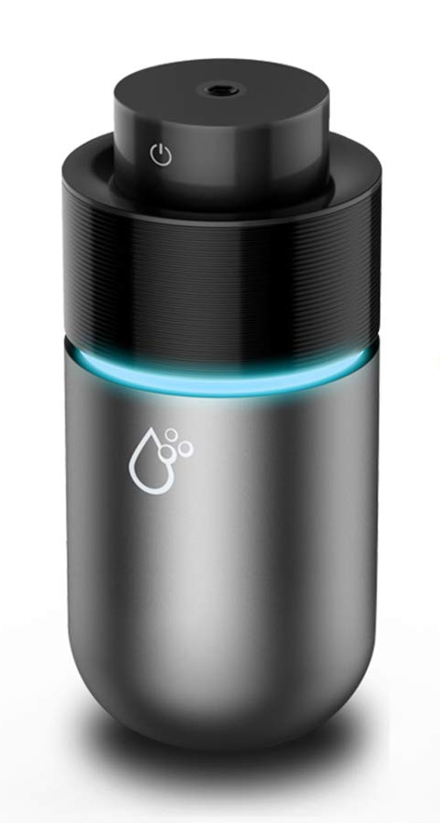
State of the Art Review
USB Car Essential Oil Diffuser (Mid Tier)
Sufficient Quality Control
“item was not working properly after I plugged it into the USB charger”
Proper Diffusion Technology
“be careful where you place this in the car … will leave a small area of water”
Notes:
Christina

Slide 8
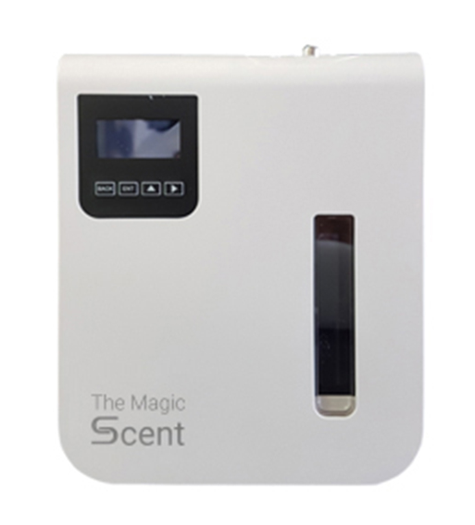
State of the Art Review
TMS 100 Aroma System (Top Tier)
Proper Diffusion Technology
“does not diffuse the oil enjoyably”
“comes out as a puff of smoke that will linger”
Appropriate Fragrance Duration
“tried multiple types of oils and none of
them lasted longer than a few days”
Notes:
Christina

Slide 9

Customer Survey
Age range?
Currently use air fresheners/diffusers? Which ones?
Purpose in your vehicle?
How much are you willing to pay?
Number of fragrances? What kind?
Mounting location?
Power source?
How to control your device?
Additional features?
Notes:
Shannon

Slide 10
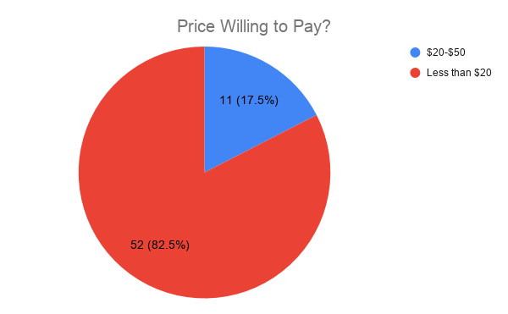

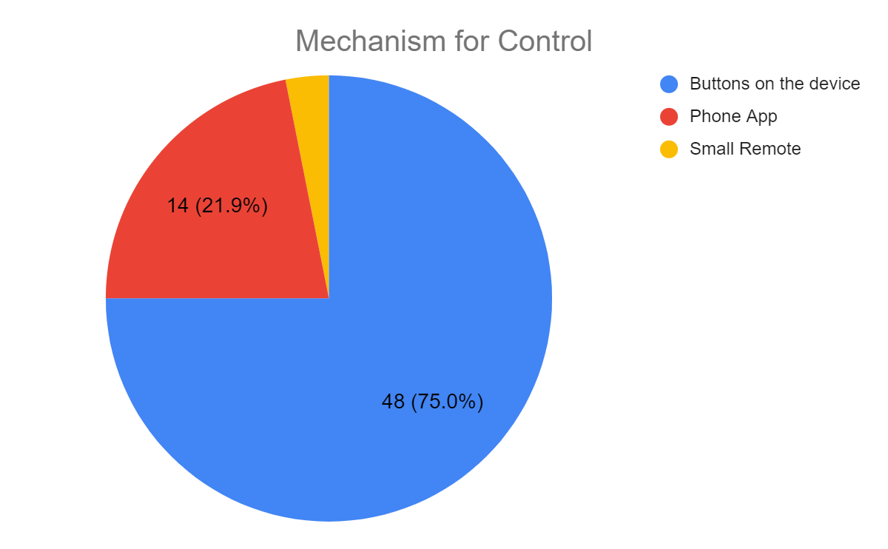

Customer Survey Results
Notes:
SHANNONON ONONONONO

Slide 11
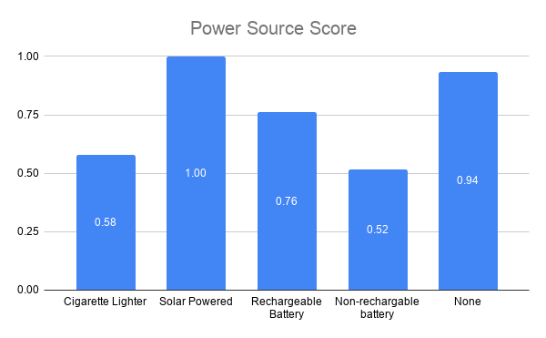

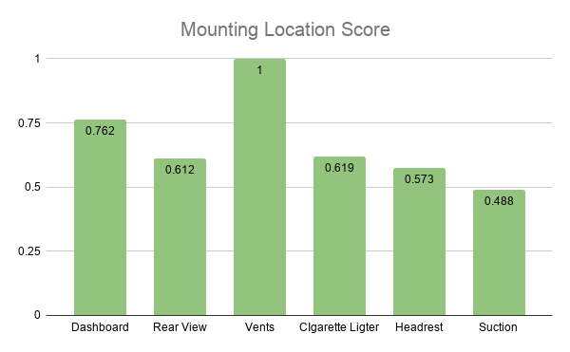

Customer Survey Results
Notes:
Shannon

Slide 12
Customer Needs
Customer Needs Table
Category | Index | Need | Priority
Cost | C1 | The product must be relatively inexpensive | 2
Cost | C2 | The product must be reusable because single use products are not economically smart | 1
Performance | P1 | The product must have a variety of settings to adjust to all customers' scent preferences | 3
Performance | P2 | The product must effectively diffuse scent through the car without distracting the driver | 1
Performance | P3 | The product scents must be long lasting | 4
Performance | P4 | The product must have other additional features on top of being a diffuser | 4
Performance | P5 | The product must have a feature allowing scents to be easily interchangeable | 3
Maintenance | M1 | The product fragrance cartridges must be easy to remove and replace | 2
Health/Safety | H1 | The product must have the ability to purify air in the car | 1
Durability | D1 | The product must be long-lasting | 3
Durability | D2 | The product must withstand different loads and forces that act in a car | 2
Notes:
SHANNONON ONONONONO

Slide 13
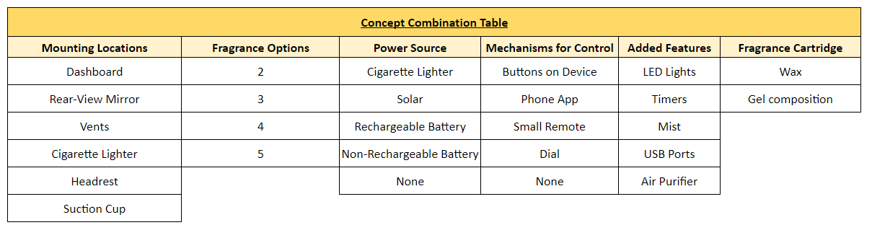
Concept Generation
General Concept Combination Table
Notes:
Trevor

Slide 14
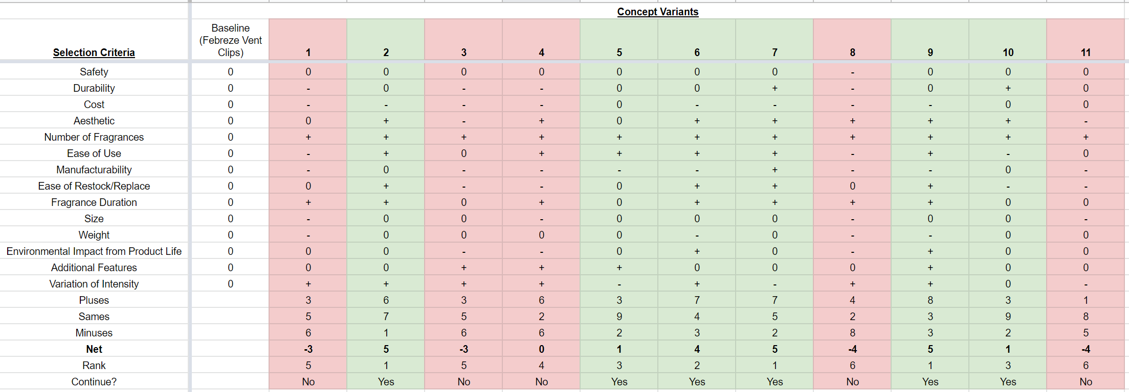
Concept Selection
Pugh Matrix
Notes:
Trevor

Slide 15
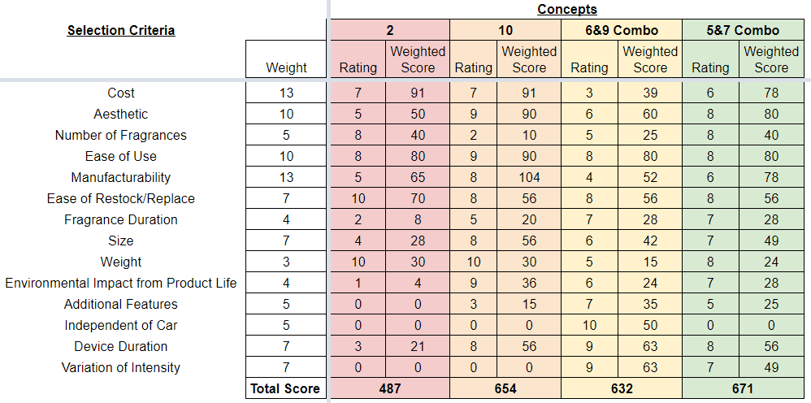
Concept Selection
Selection Matrix - Finalized Concepts
Notes:
Trevor

Slide 16
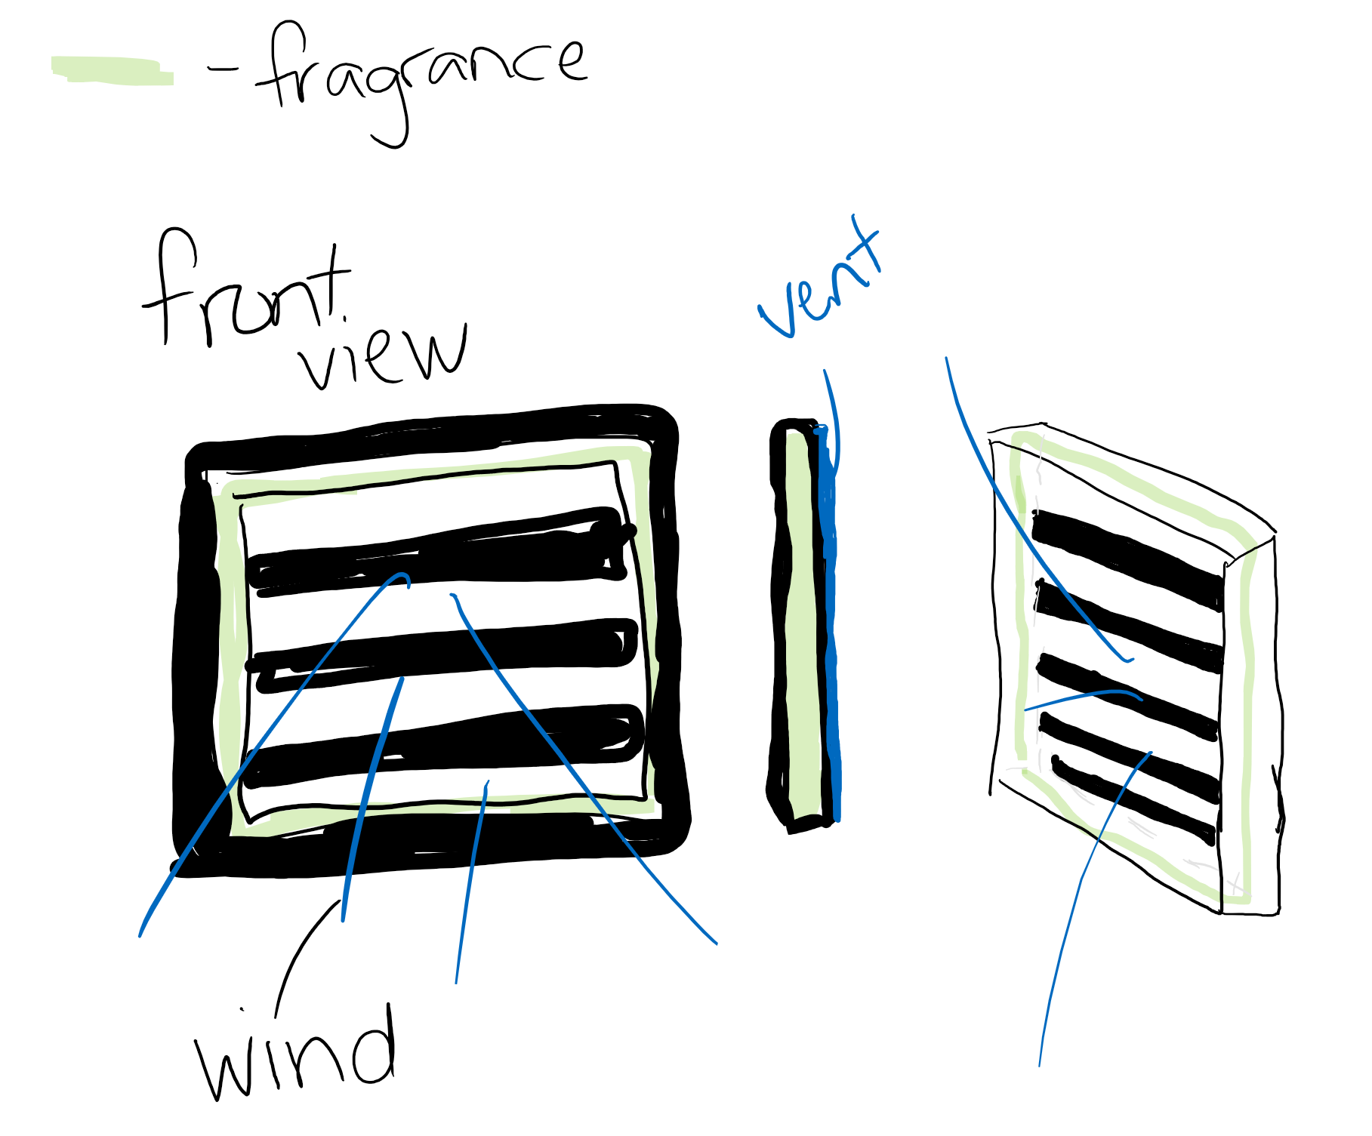
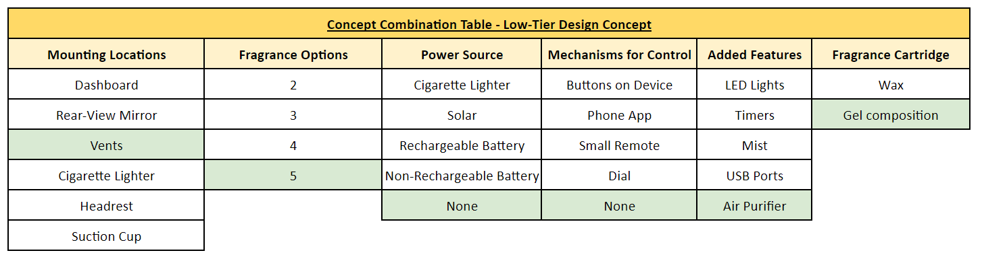
Design Concepts
Low Tier
Notes:
shannon

Slide 17
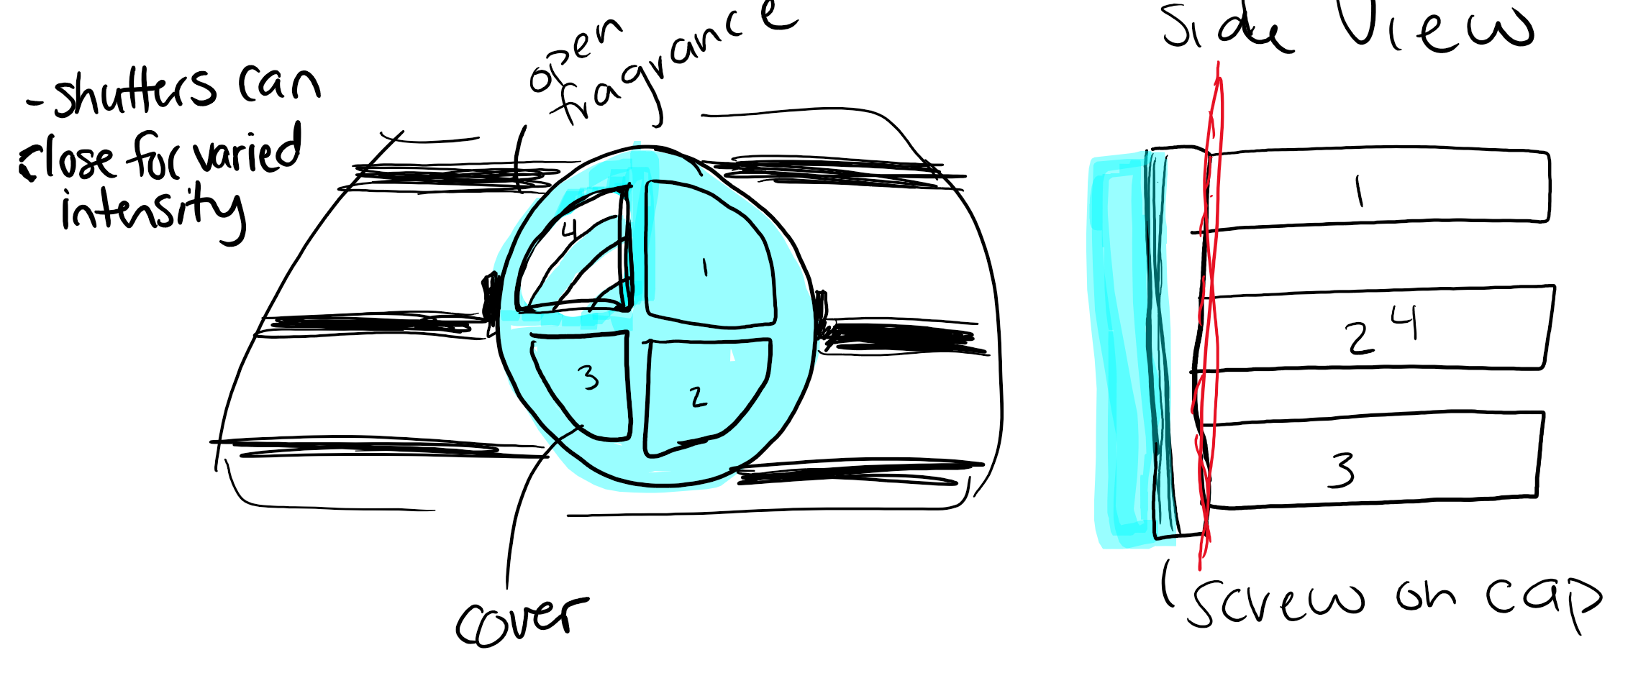
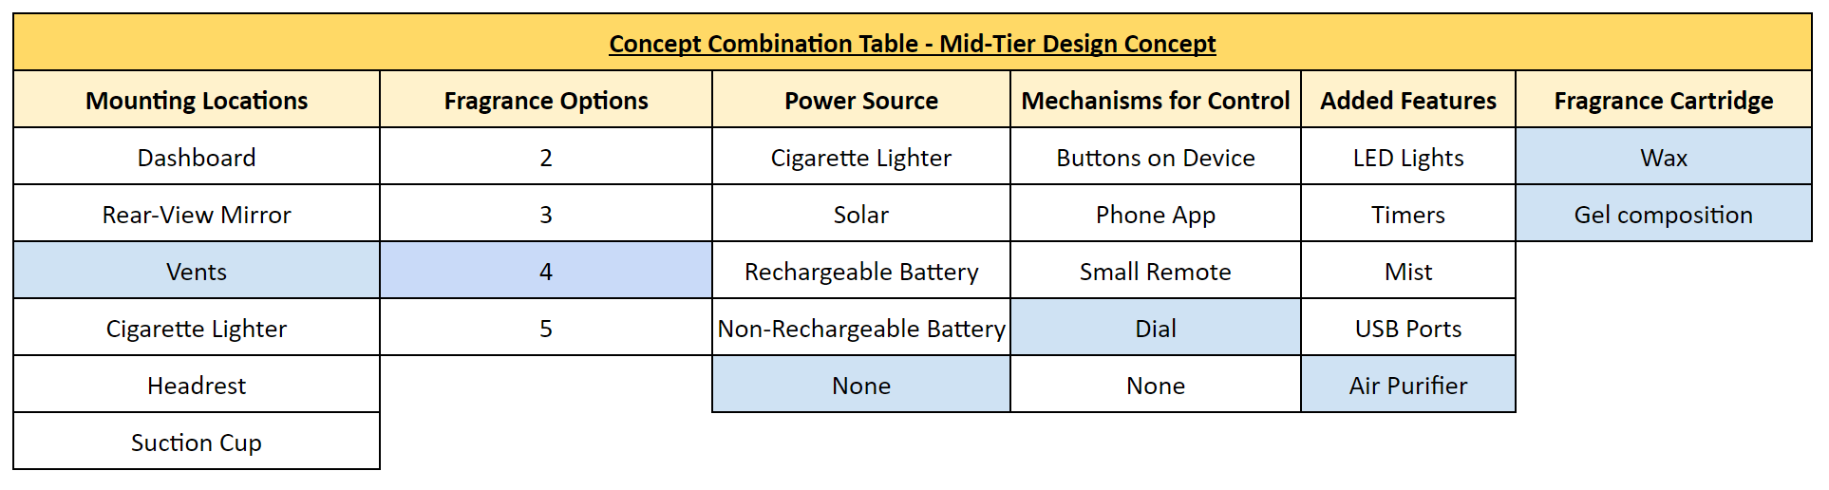
Design Concepts
Mid Tier
Notes:
maddie

Slide 18
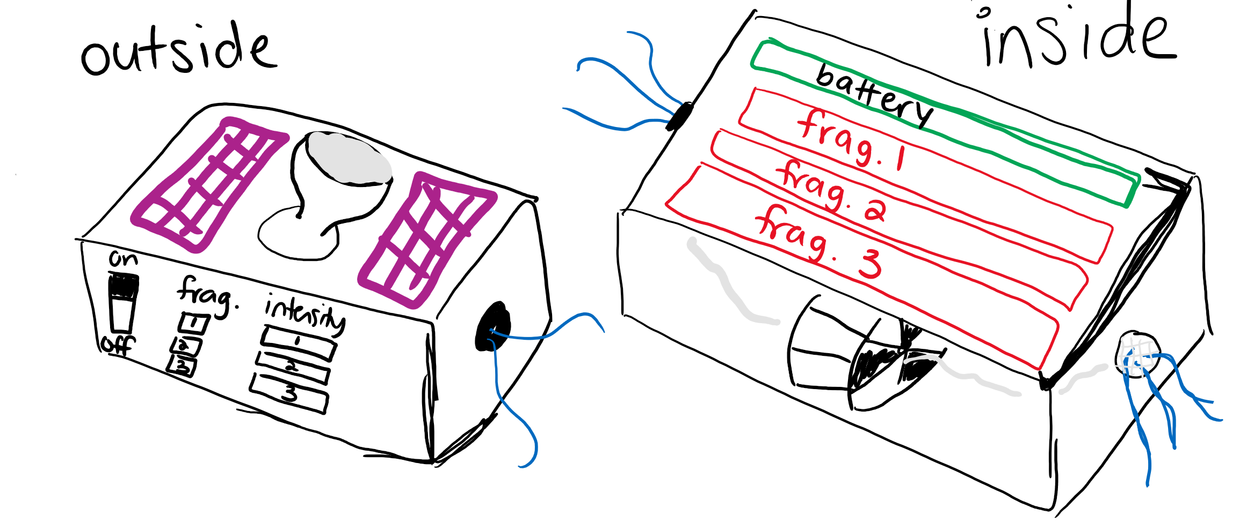
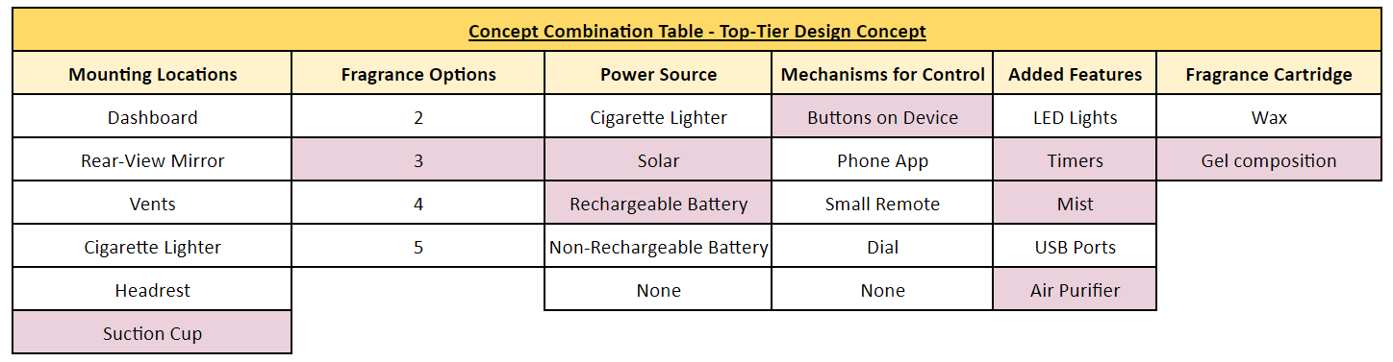
Design Concepts
Top Tier
Notes:
Christina

Slide 19
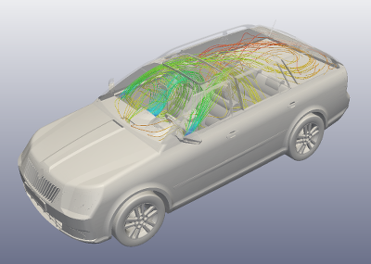
Technical Analysis
Required airflow to spread the scent throughout the entire car
Air volume displaced over time
SolidWorks Simulation illustrating air flow within various cars
Required voltage to power the device
Look up various fan sizes
Battery life of the product
Choosing a handful of fans and calculating the
battery life at various intensities
Duration of fragrance on different intensities
Dependent on air flow velocity,
exposed surface area, size of the device
Notes:
Trevor

Slide 20
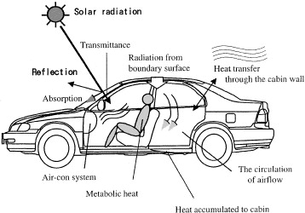
Technical Analysis
Product's ability to withstand forces met within a car
Using the product size and weight
Calculate required attachment strength/durability
Product's ability to withstand temperatures met within a car
Select materials that will not be affected by extreme temperatures

Slide 21
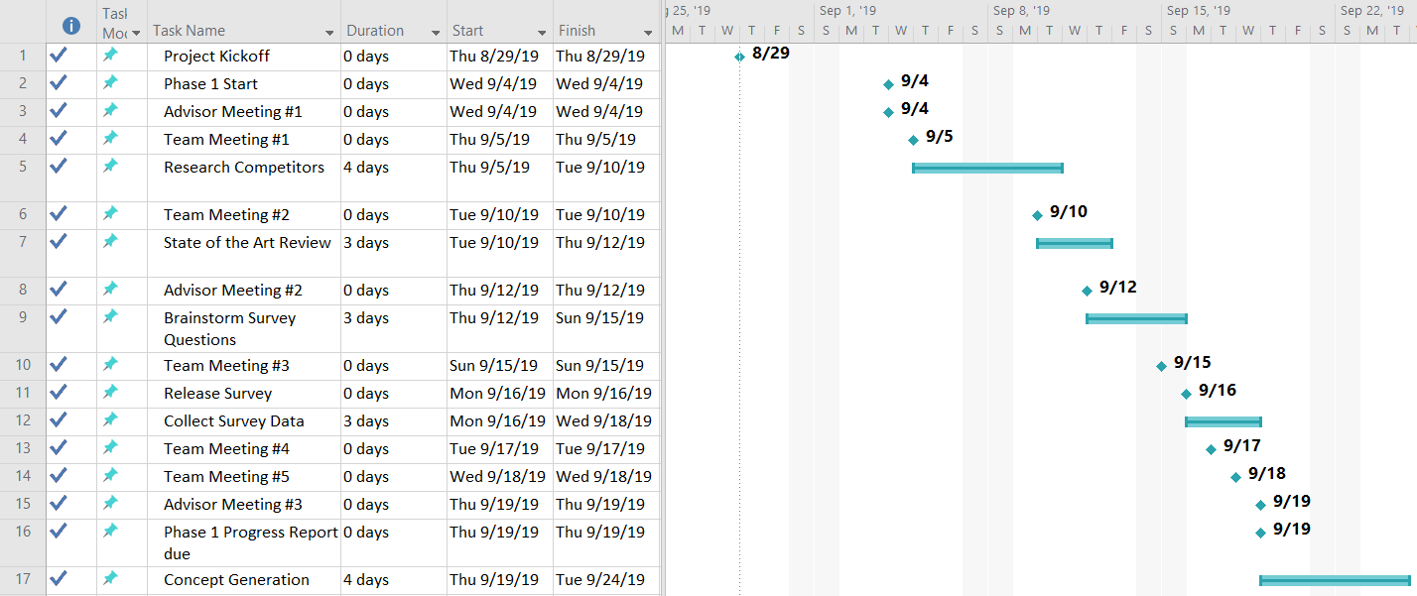
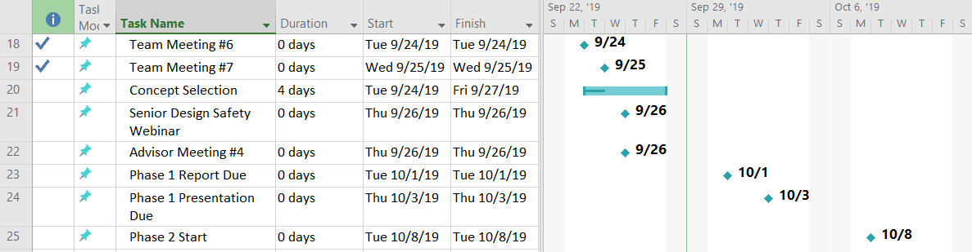
Project Plan
Phase 1 Gantt Chart
Notes:
maddie

Slide 22
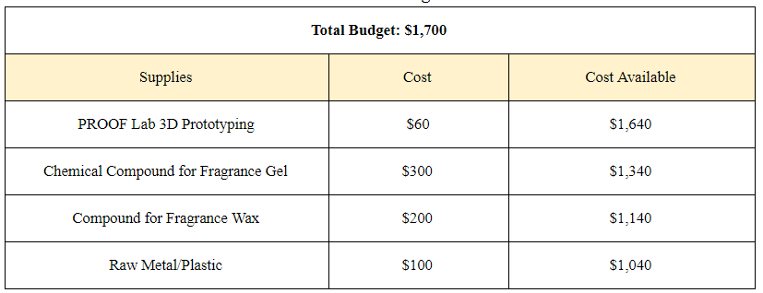
Project Plan
Team Budget
Sponsorship: $1,000
ME Department: $700
Notes:
maddie

Slide 23

Moving Forward
Phase 2
Initial Design
In-Depth Technical Analysis
CAD simulations (air flow)
Power (voltage)
Forces
Temperature
Material Selection
Prototyping Research
Notes:
maddie

Slide 24
Questions?
Thank you!

Slide 25
References
AkihiroFujitaaJun-ichiKanemaruaHiroshiNakagawaaYoshiichiOzekib, Author links open overlay, et al. “Numerical
Simulation Method to Predict the Thermal Environment inside a Car Cabin.” JSAE Review, No Longer
Published by Elsevier, 31 Jan. 2001, www.sciencedirect.com/science/article/pii/S0389430400001016.Brenda. “Top 10 Best Portable Essential Oil Diffusers for Your Car Traveling.” Air Life
Better, 21 May 2019, www.airlifebetter.com/essential-oil-car-diffusers/.
“Car Air Freshener: Febreze CAR.” Air Fresheners & Odor-Eliminating Products,
www.febreze.com/en-us/products/products-by-type/car-vent-clip-freshener.
“Good Air®.” Yankee Candle Company, Yankee Candle,
www.yankeecandle.com/wbrowse/good-air/_/N-8ii.
“Scent Diffuser.” Westin Hotel Store, Westin Hotels,
www.westinstore.com/product.aspx?scent-diffuser.
SimScale. “SimScale Platform - Simulation in Your Browser.” SimScale,
www.simscale.com/projects/Ali_Arafat/car_cabin_air_flow_analysis/.
“TMS 100 Aroma System (1,000sq.Ft).” TMS, The Magic Scent,
www.themagicscent.com/shop/2-technologies/tms-100/.
Ways. “Best Car Essential Oil Diffuser.” Byways, 3 July 2019,
www.byways.org/best-car-essential-oil-diffuser/.

